Slide 1
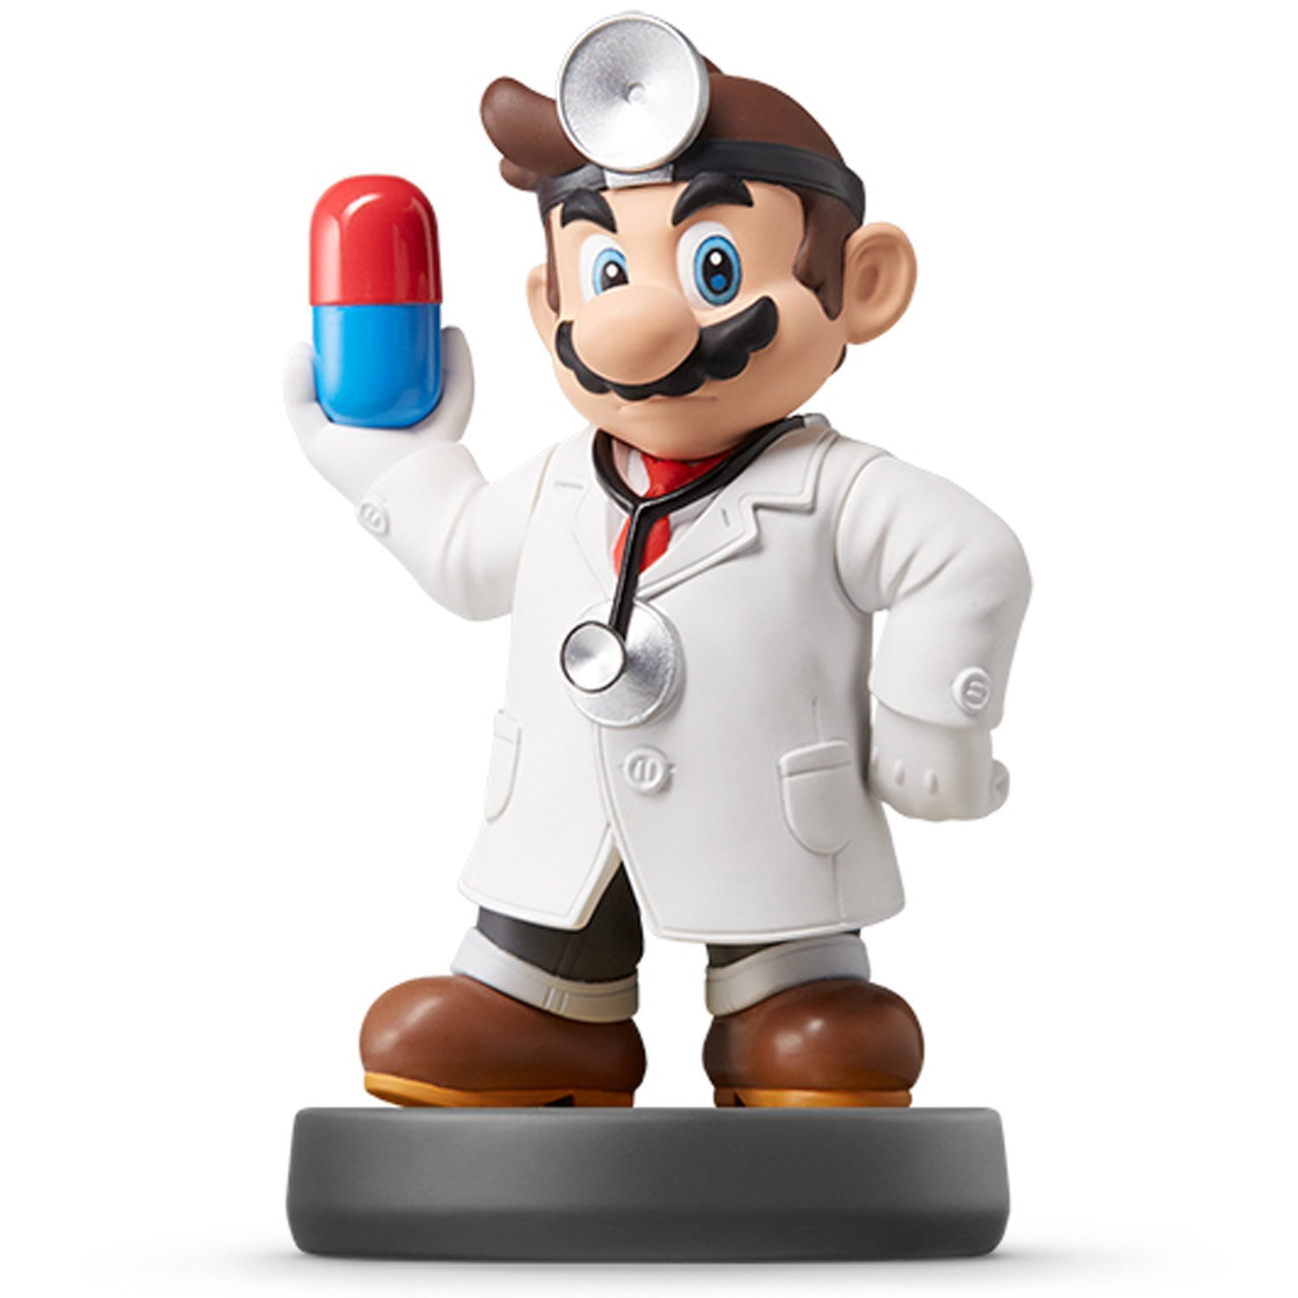
Joins II

Slide 2
Joins Assignment
Instructions
Download Analysis 2 Zip Folder
Unzip Folder
Open Analysis 2 Rmd File
Knit to HTML
Read Introduction
Three Part Assignment
Each Part Self-Contained
Part 1: Gather/Spread
Part 2: Joins
Part 3: Webscraping

Slide 3
Part 1: Cholesterol
Closely Examine Datasets
Cholesterol
Cholesterol2
Goals
Clean Datasets Separately
Merge According to According to Brand
Things to Consider
Experimental Dataset is the “Main” Dataset
Requires Knowledge of How to Merge When Variable Names are Different

Slide 4
Part 2: Crimes
Goals
Attention to Detail
Merge All 5 Datasets
Practice with the Practical
Things to Consider
Violent Crimes Data is the “Main” Dataset
Only Want Information for States Not Classified as Safe or Dangerous
Requires Cleaning
Repeatedly Use View Function
> ifelse(VAR==“OLD”, “NEW”, VAR)

Slide 5
Part 3: Wikipedia
Goals
Search Through Wikipedia for a Table
Copy the URL to Rmd File
Describe Table
Scrape Table
Things to Consider
Utilize Code from Webscraping Tutorial
Run Code in Parts
Check Final Table to Make Sure It Worked

Slide 6
Closing
Disperse and Make Reasonable Decisions

